Slide 1

Matthew Dittrich Eslam Zenhom

Slide 2

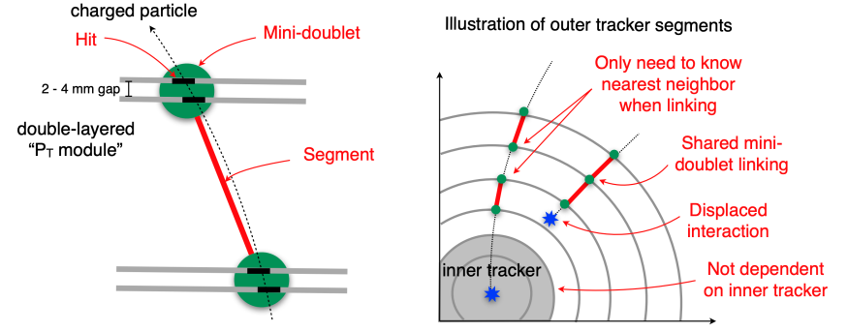
Charged particle trajectory in a tracker

Slide 3
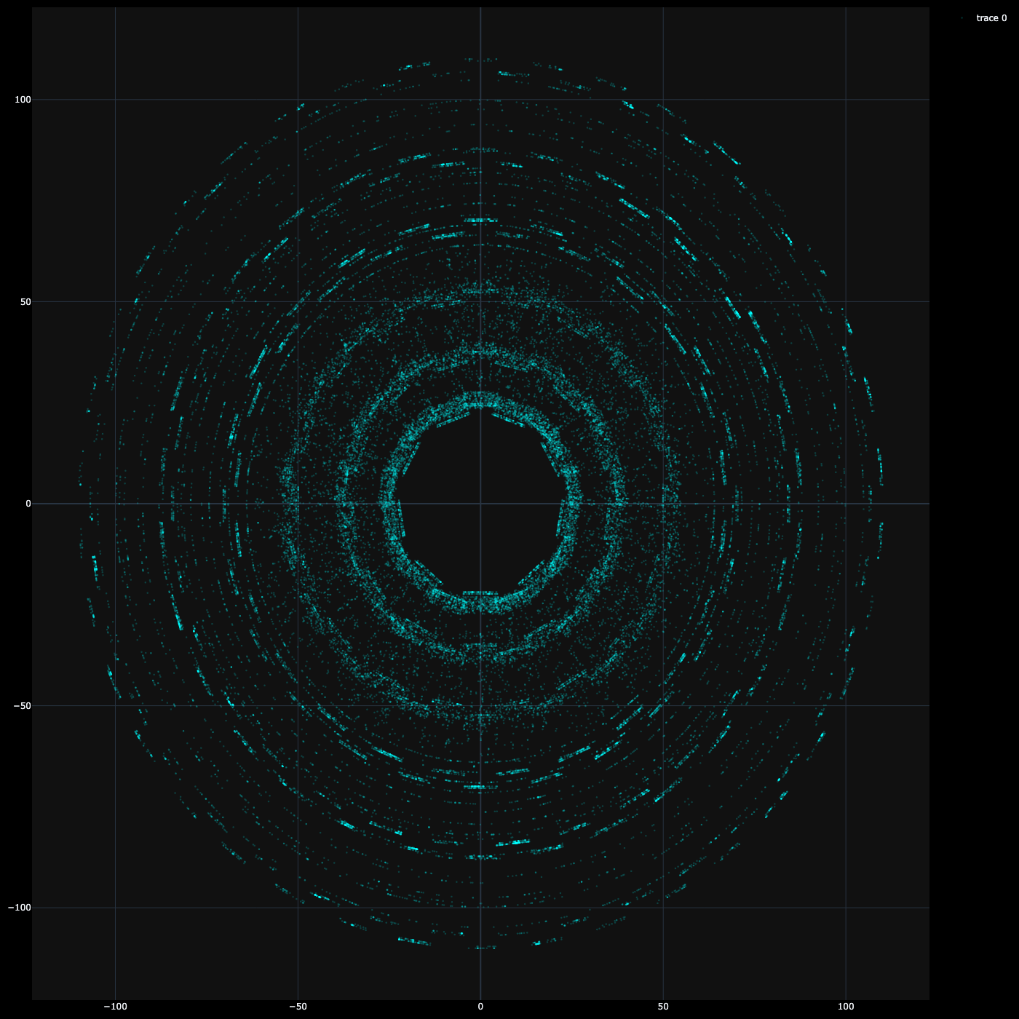
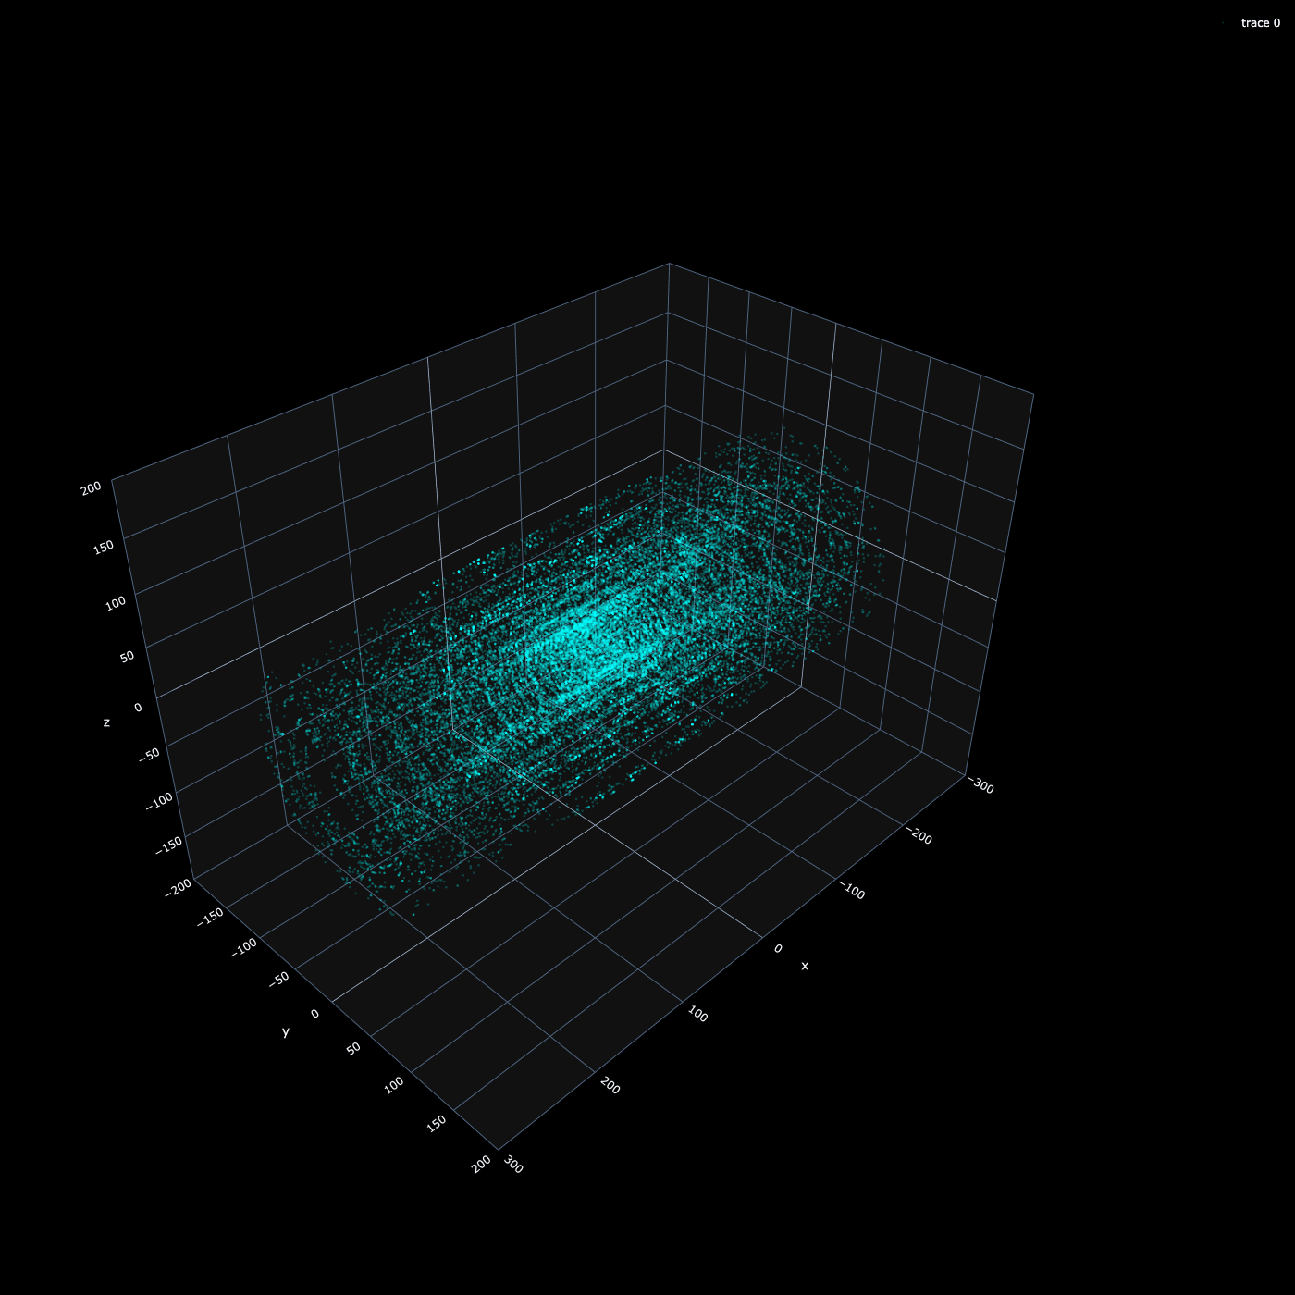
Mini-Doublets are Nodes (MD)

Slide 4
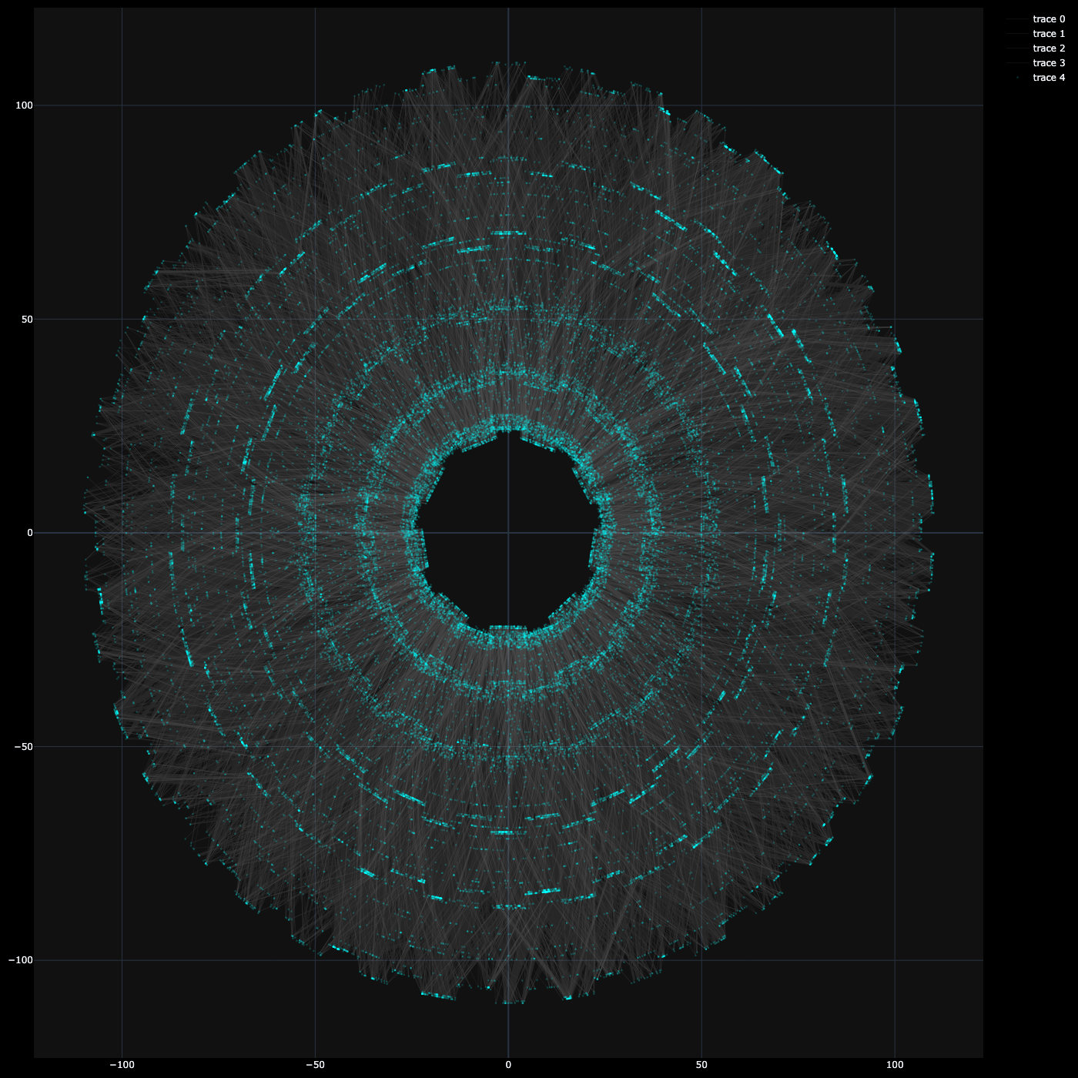
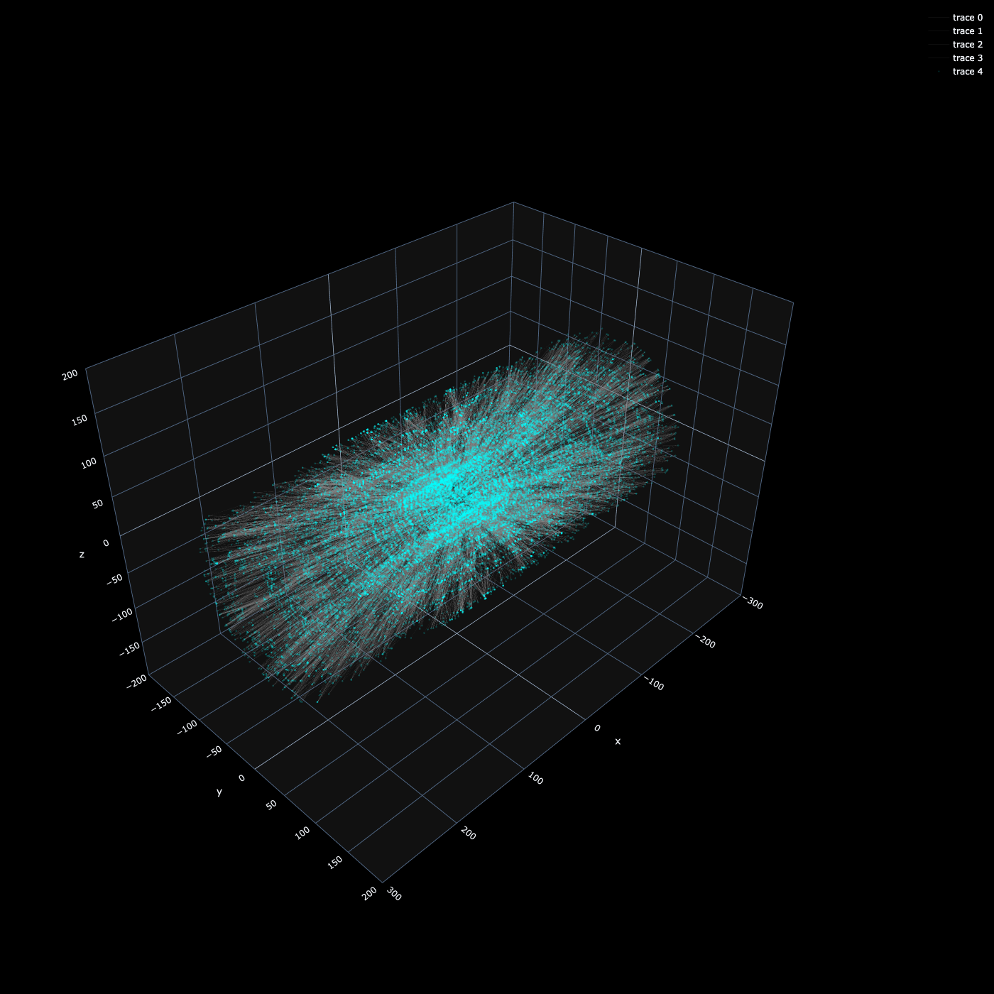
Line Segments are Edges (LS)

Slide 5
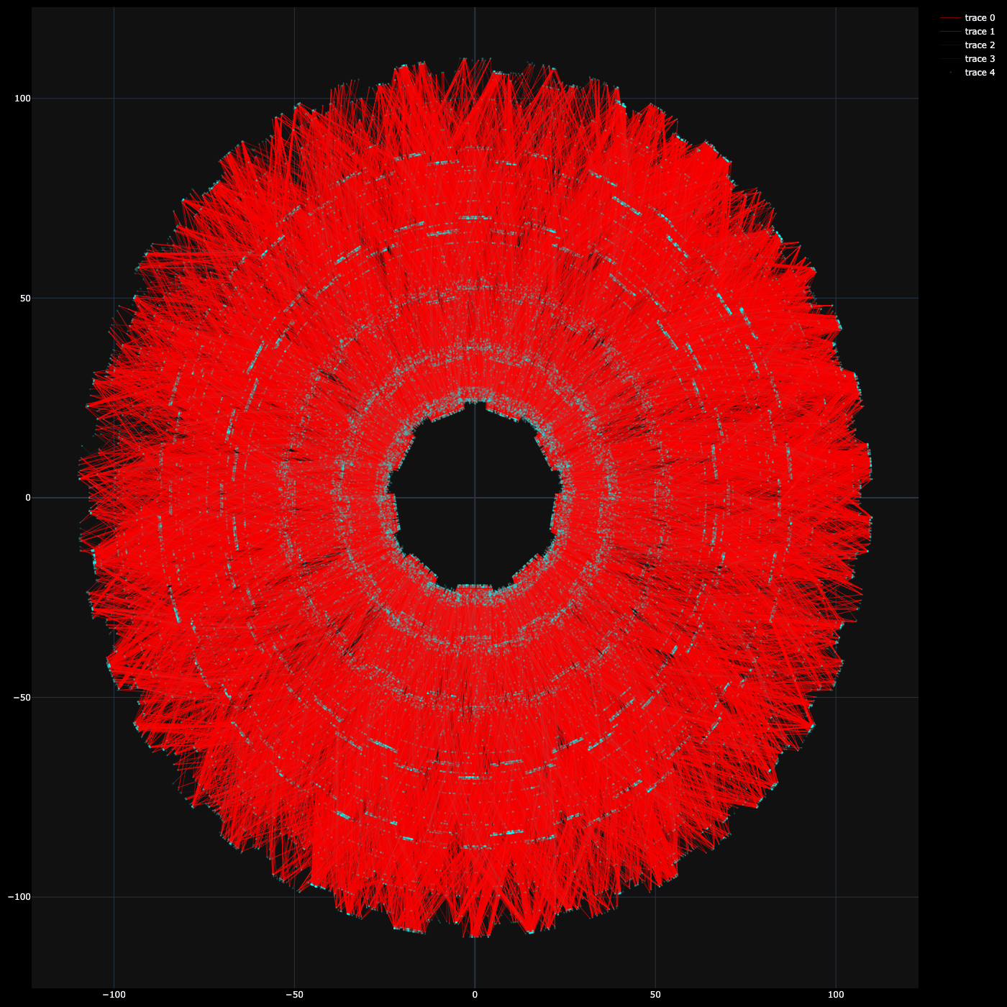
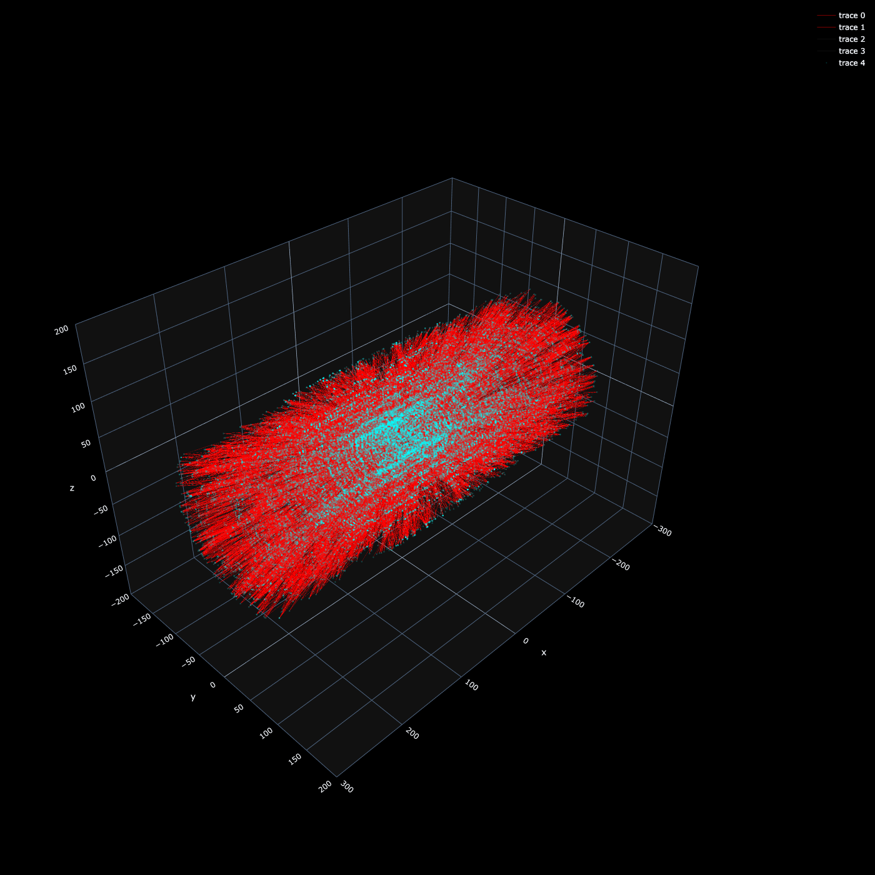
Fake Edges
Fake: when not all hits in the line segment matched to a unique simulated track

Slide 6
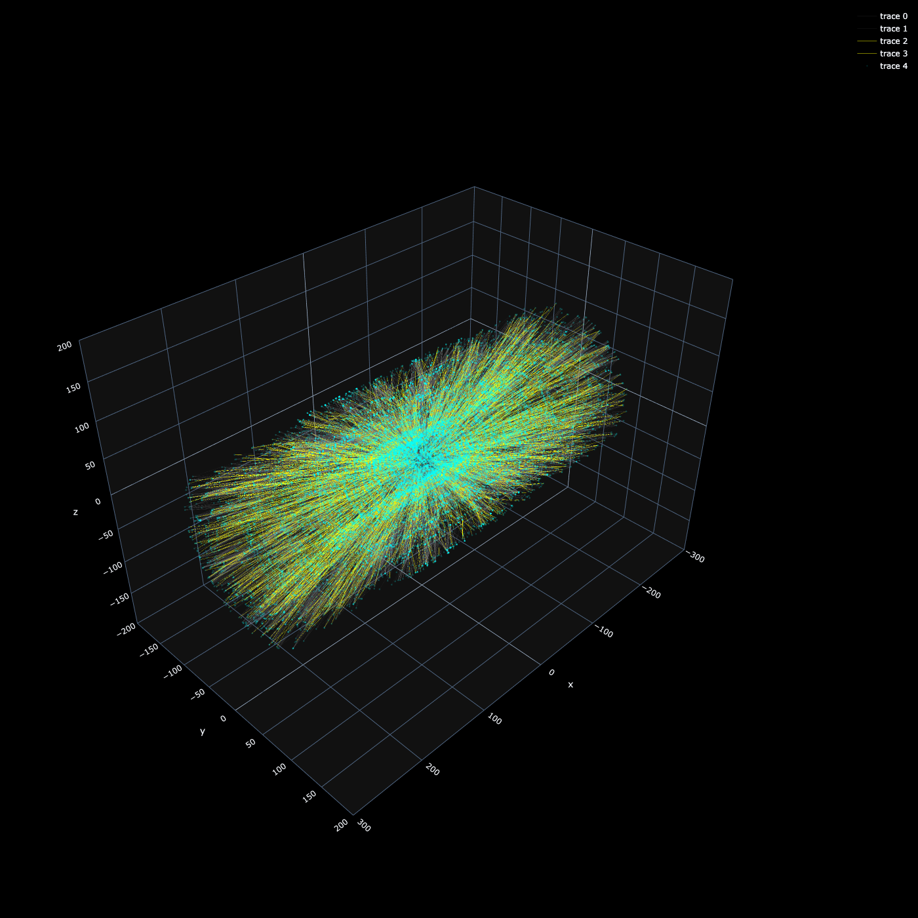
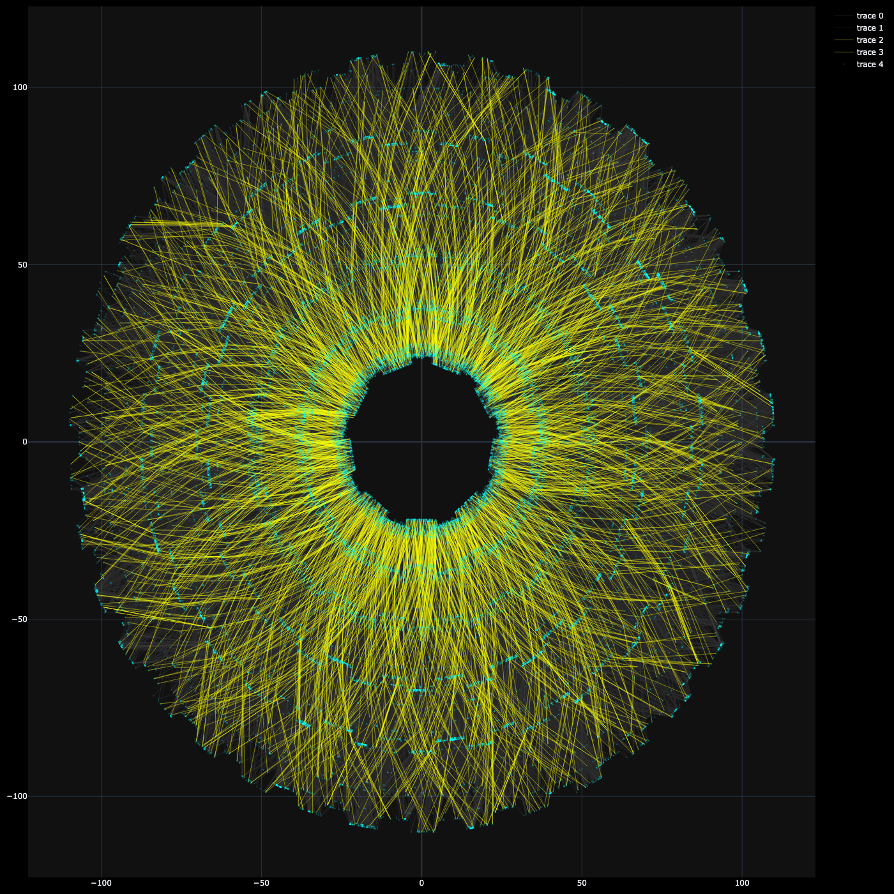
True Edges
True: when all hits in the line segment matched to a unique simulated track

Slide 7
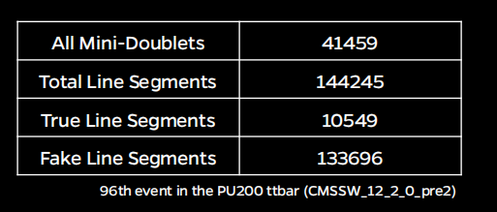
Numbers for a specific events

Slide 8
Graph Neural Network training
Used PU 200 ttbar sample (first 95 events in CMSSW_12_2_0_pre2)
The 96th event is used as a test (the ones shown in previous slide)

Slide 9
Training inputs
Node features:
xyz positions of mini-doublets
∆ϕ change (our MD pt estimator)
Edge features :
pt, eta, phi estimates based on two anchor MD points

Slide 10
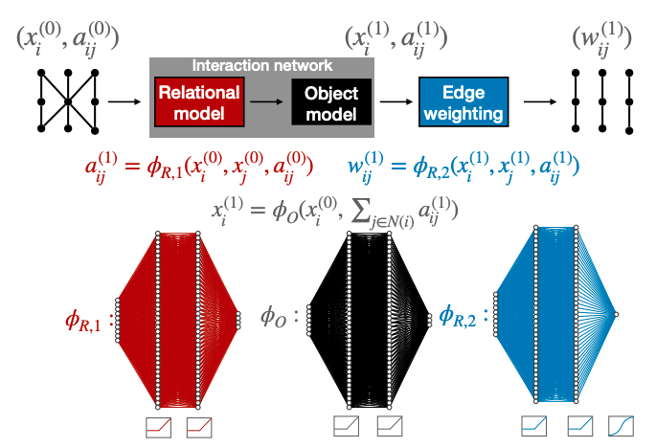
Training model
“Interaction Network” https://arxiv.org/pdf/2103.16701.pdf

Slide 11
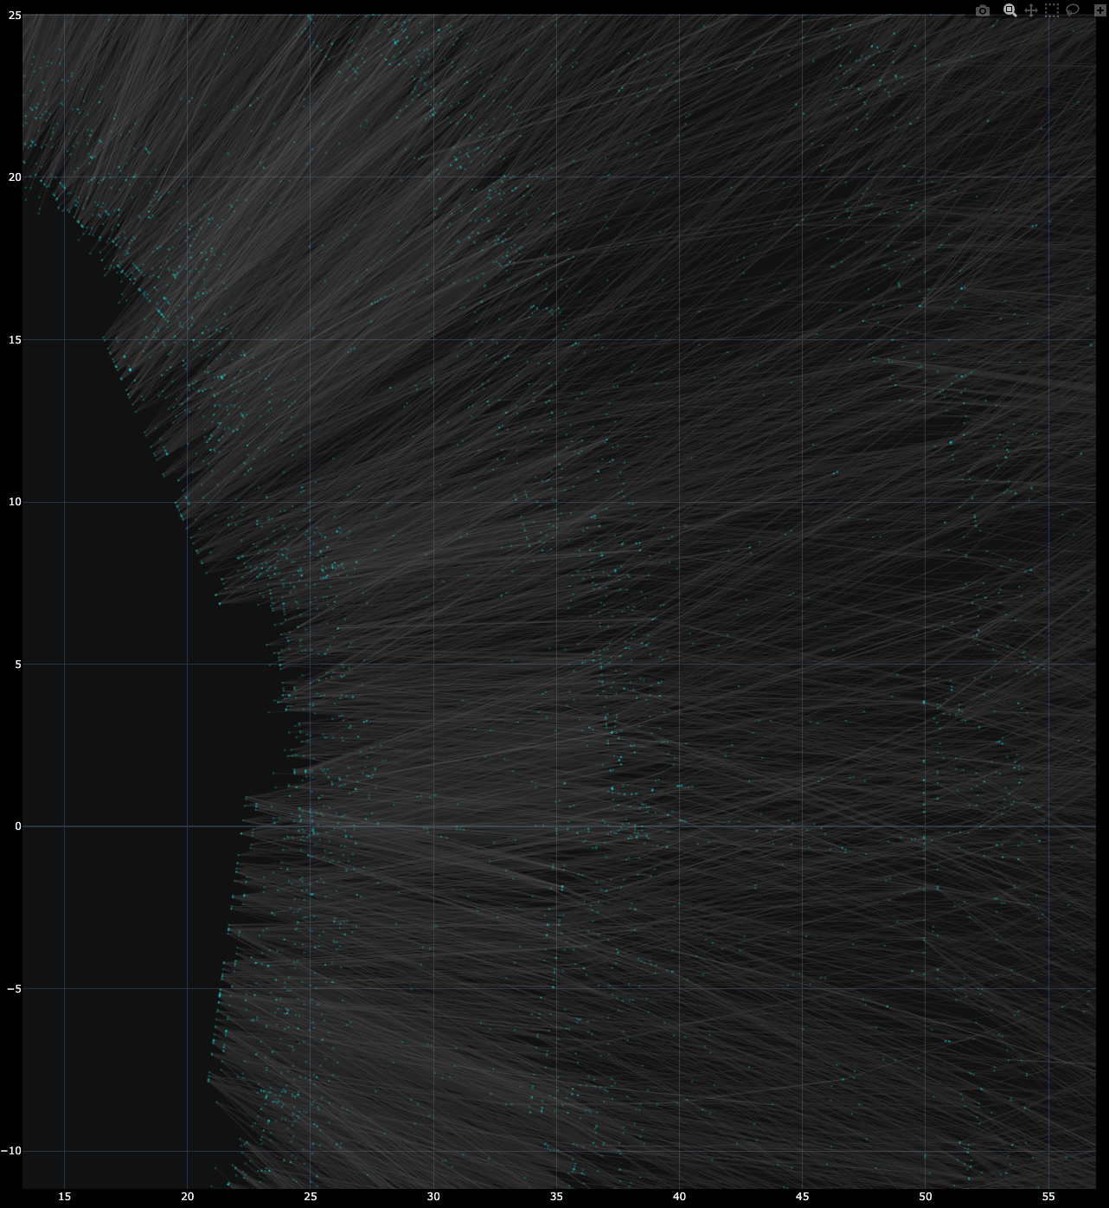
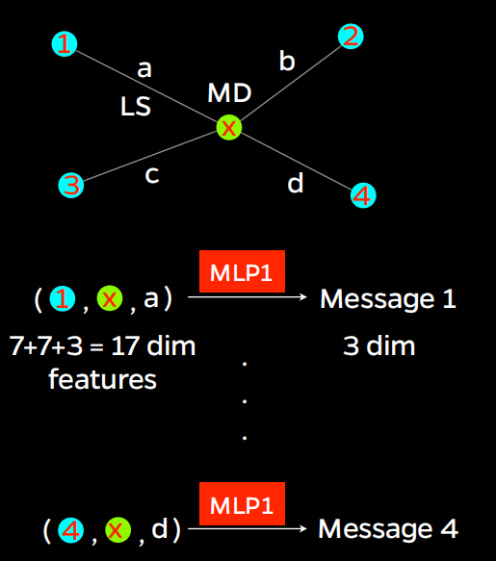
Training Model

Slide 12
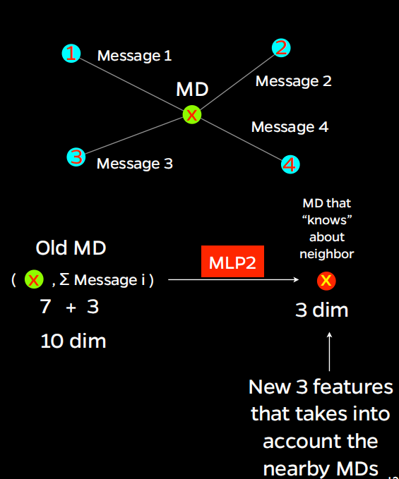
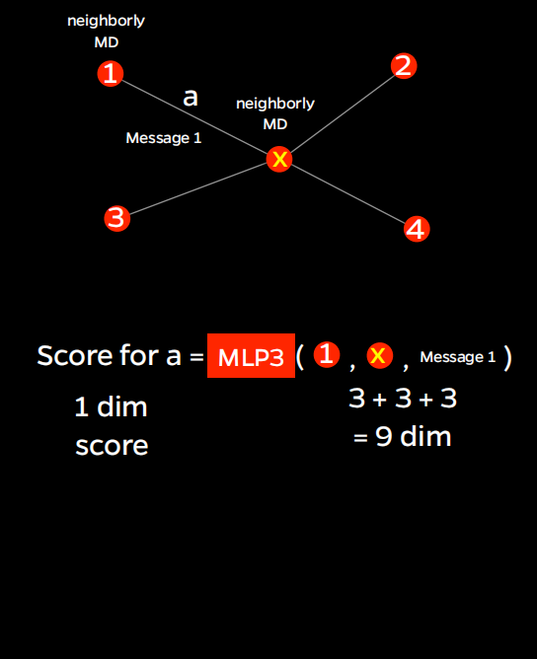
Training Model

Slide 13
The MLPs to be trained
There are 3 MLPs being trained:
MLP to compute message based on two MDs, and the LS
MLP to compute aggregate messages and output “neighborly” MD
MLP to take “neighborly” MDs and message to classify the LS

Slide 14
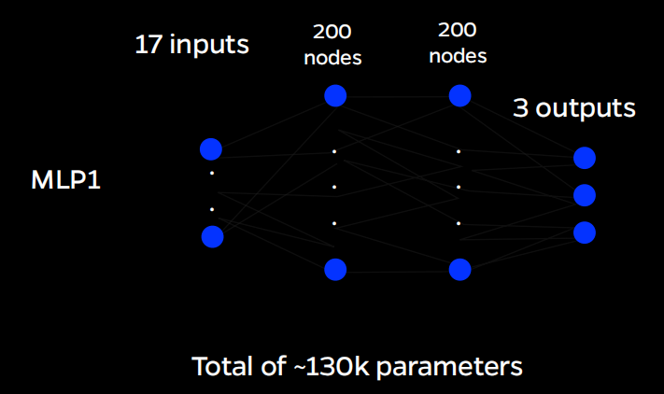
Hidden layers in the MLPs
MLP1 had 17 inputs, 3 outputs
MLP2 had 10 inputs, 3 outputs
MLP3 had 9 inputs, 1 output
Each had 2 layers with hidden nodes of 200

Slide 15
Edge Output Distribution
Epoch 1
Epoch 25
Epoch 50

Slide 16
Inference Testing
Ran inference on separate Event (still 200 PU)
Made cut at 0.0774
True positive rate = True negative rate
Future work will involve optimizing this cut value

Slide 17
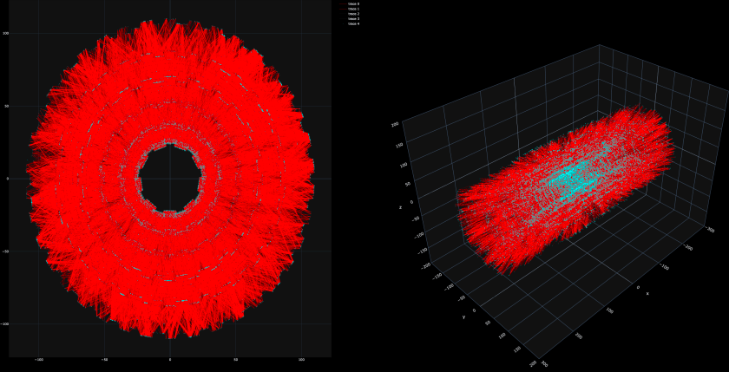
Fake Edge Reduction – Before

Slide 18
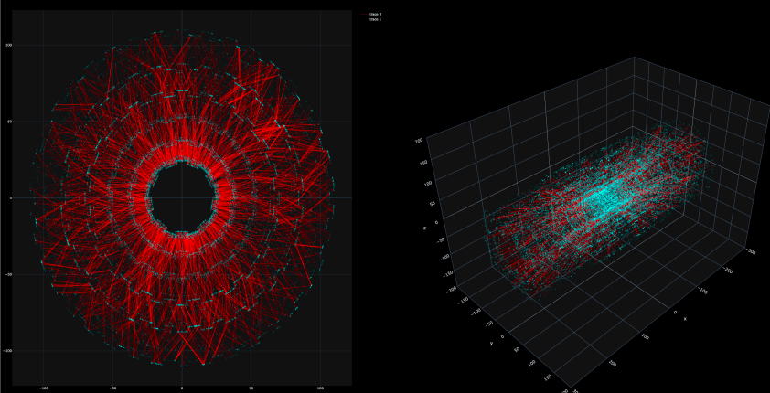
Fake Edge Reduction – After

Slide 19
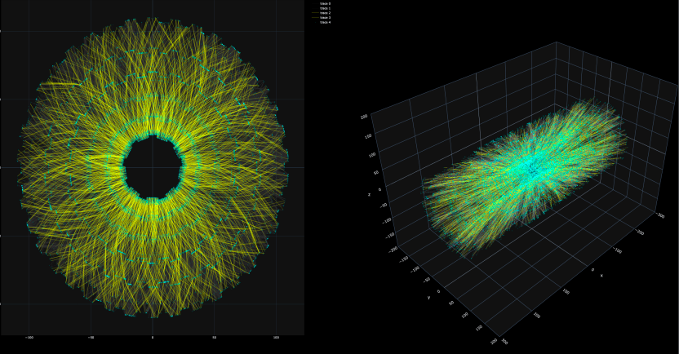
True Edge Retention - Before

Slide 20
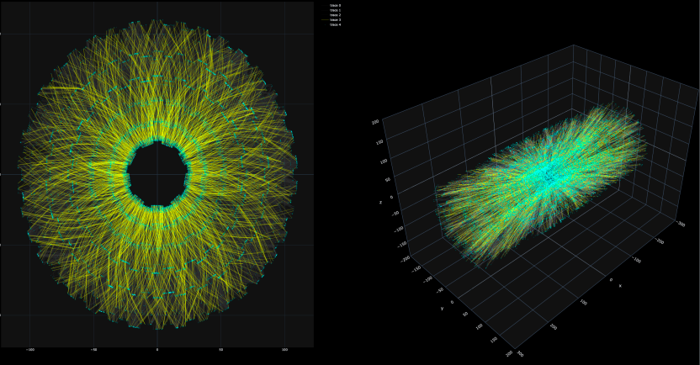
True Edge Retention - After

Slide 21
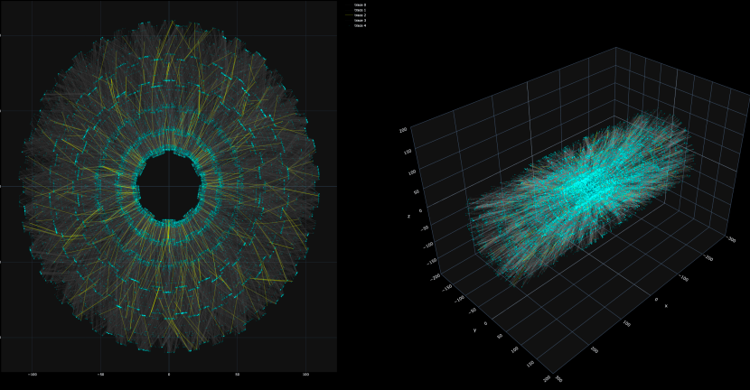

True Edge Removal

Slide 22
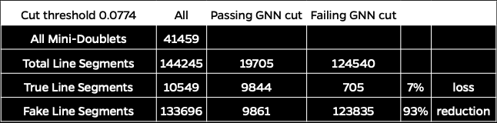
Tally

Slide 23
Future Work
Optimizing the cut value
Loss function is still quite high
MLP layer messages?
Normalizing data?
Learning Rate?
100 Epoch
LR 0.001
Do we need every LS for reconstruction? – NO
LST is getting >99% with ~ 4000 tracks
Are we getting the right ones?
50 Epoch
LR 0.005

Slide 24
Outline

